Slide 1
FIFA 19
EXPLORATORY DATA ANALYSIS

Slide 2
What is meant by EDA ?
Exploratory Data Analysis (EDA) is an approach to analyze the data using visual techniques. It is used to discover trends, patterns, or to check assumptions with the help of statistical summary and graphical representations.

Slide 3
About FIFA WORLD CUP :
The FIFA World Cup, often simply called the World Cup, is an
international association football competition contested by the
senior men's national teams of the members of the Fédération
Internationale de Football Association (FIFA), the sport's global
governing body.

Slide 4
fifa_eda dataset:
Our dataset consists of 18 attributes about 18207 players including their :
ID
NAME
NATIONALITY
WAGE
CLUB
HEIGHT
WEIGHT
RELATIVE CLAUSE
Etc.

Slide 5
Data cleaning:
Dataset cleaning is an important set of any EDA as it will help in understanding the patterns well. We will start by seeing whether the dataset has any null values or not.
We see that the attributes such as 'Club’, 'Contract Valid Until’, 'International Reputation’, 'Skill Moves’, 'Value' contains null values. We removed the tuples which contain such null values

Slide 6
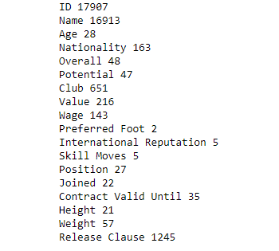
EDA and Modelling:
1. Checking no of unique instant of an attribute
We got details regarding unique instant of each attribute as given.

Slide 7
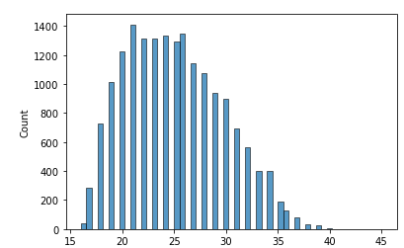
2.To find median age
Median age of players is about 25

Slide 8
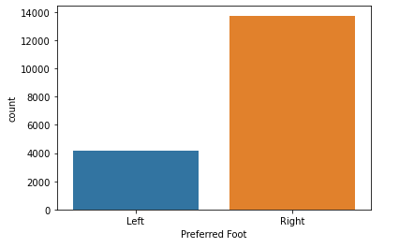
3. Check whether majority of players prefer left foot or right foot.
Most people prefer right foot.

Slide 9
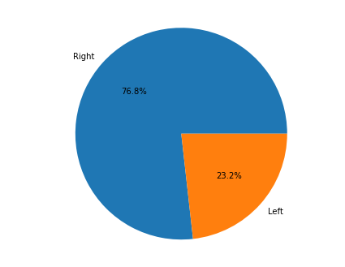
4.Check how much percentage of players prefer left foot or right foot.
76.8% prefer right foot.

Slide 10
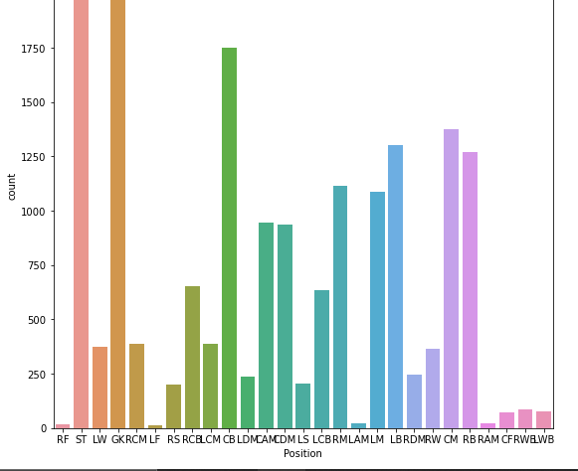
5. To find which position most players are play in.
It seems as though most players play in the ST position

Slide 11
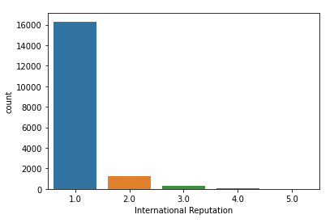
6. To find how strong are their reputation on a scale of 1-5.
This gives us any early idea as to how many players have the highest international reputation.

Slide 12
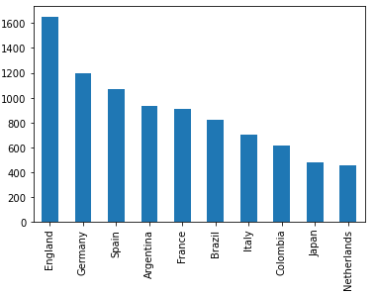
7. To find the top 10 countries with the most players in FIFA.

Slide 13
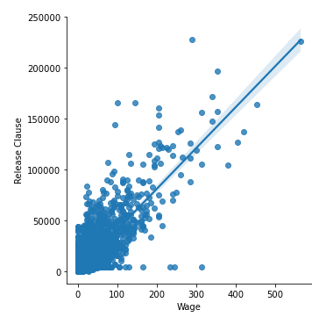
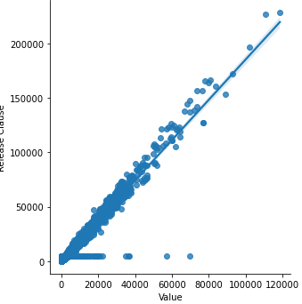
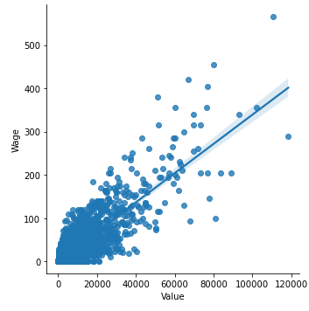
8. To find relation between Wage, Release Clause and Value.

Slide 14
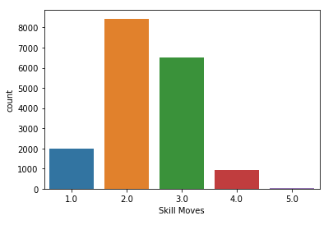
9. To know about Skill Moves of a Player
Most of the players are of skill set point 2.

Slide 15
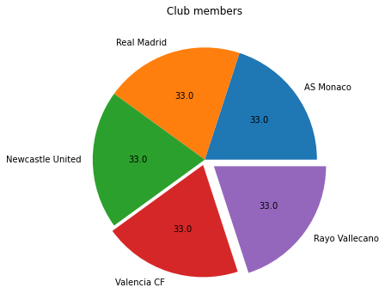
10. Top 5 clubs with most players.

